Slide 1


MONTHLY PERFORMANCE REVIEW
GCG (US Hispanic) - Paid Media
March 2026
Google Ads · Meta · Quantcast · Azerion
Prepared by Berelvant · 04.13.2026

Slide 2
FOREX.com | GCG US Hispanic - March 2026
EXECUTIVE SUMMARY
Total Spend March
Channel | Status | Spend | Impressions | Clicks | CTR | Conversions | CPA / Cost-per-event
Google Ads (Search) | Live | $15,209 | 122,836 | 9,711 | 7.91% | 0 tracked | N/A - no pixel
Meta (CTR) | Live | $5,946 | 325,752 | 11,323 | 3.46% | 53 Start / 1 Submit | $112 / Start App
Quantcast (Programmatic) | Live | $12,159 | 5,856,016 | 1,241 | 0.02% | 2 VT | $5,830 CPA - no pixel
Azerion (Programmatic) | Live | $15,793 | 2,494,890 | 3,028 | 0.12% | 7 | $2,256 CPA - no pixel
TOTAL / BLENDED | - | $49,107 | 8,799,494 | 25,303 | 0.29% | 62 events | -
HEADLINES
CRITICAL ISSUE
Google Ads delivered 9,711 clicks at 7.91% CTR. Campaigns ran budget-limited throughout March, indicating strong demand. Conversion tracking setup is in progress with the Central Team.
Meta generated 53 Start Applications at $112 CPA — competitive for the financial services category.
Quantcast delivered 5.9M impressions at $1.99 CPM across the US Hispanic audience.
Azerion launched mid-March and produced 7 conversions at $2,256 CPA in a ramp-up period.
APRIL PRIORITY: COMPLETE TRACKING SETUP
Conversion tracking is in progress across Google Ads, Meta, and programmatic channels via the Central Team. Once live, full-funnel CPA and ROAS reporting becomes available. Campaign CIDs from Mateus and Laura are also needed to enable cross-system attribution. These two items are the primary prerequisites for a complete April performance read
Monthly Performance Review
2 / 10

Slide 3
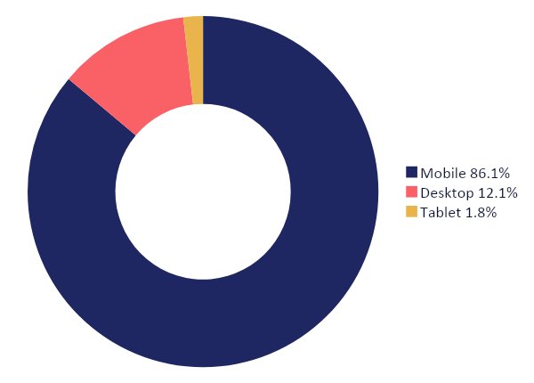
FOREX.com | GCG US Hispanic - March 2026
GOOGLE ADS · PERFORMANCE
Strong delivery from CTR standpoint
SPEND
IMPRESSIONS
CLICKS
CTR
AVG CPC
CONVERSIONS
$15,209
122,836
9,711
7.91%
$1.57
0
No pixel
Campaign Breakdown
Device Mix (% of spend)
Campaign | Spend | CTR | Avg CPC | Search IS | Rank Lost
TrackA Trust (Non-Brand) | $5,320 | 10.08% | $1.08 | 10.6% | 76.1%
TrackB Authority (Non-Brand) | $4,560 | 7.45% | $1.70 | 16.9% | 71.2%
TrackB Platform (Non-Brand) | $3,040 | 5.37% | $1.56 | 10.0% | 81.1%
Brand Search | $2,288 | 9.29% | $12.64 | 69.1% | 21.0%
Highlights
Search is generating high-intent traffic at efficient cost. A 7.91% blended CTR and $1.57 average CPC are strong for financial services in the US Hispanic market. Brand Search captured 69.1% impression share at $12.64 CPC — the highest-efficiency unit in the account.
Non-brand campaigns ran budget-limited throughout March, with impression share ranging from 10-17%. Rank Lost is driven by budget ceiling, not Quality Score. This indicates demand exceeds current allocation — a relevant input for April budget planning.
Conversion tracking setup is in progress with the Central Team. Performance against bottom-funnel KPIs will be available once that is complete.
Monthly Performance Review
3 / 10

Slide 4
FOREX.com | GCG US Hispanic - March 2026
· GOOGLE ADS · HIGHLIGHTS & NEXT STEPS
Unlock measurement, then lean into demand
HIGHLIGHTS
CHALLENGES / RISKS
TrackA Trust is top performer: 10.08% CTR at $1.08 CPC.
Non-brand budgets fully utilized (97-99%) - strong demand signal.
Spanish-intent terms hit 11-68% CTR - audience is there.
Mobile = 86% of spend; aligns with US Hispanic behavior.
Conversion tracking setup in progress. Bottom-funnel data available once complete.
Non-brand impression share is 10-17%. Budget ceiling is the primary constraint — not keyword quality.
Brand Search has room for match type refinement to improve efficiency.
Low-intent English terms identified for exclusion. Ad relevance improvements queued for non-brand campaigns.
Priority | Recommendation | Next Step | Owner / Due
CRITICAL | Complete conversion tracking setup. | Central Team to finalize pixel configuration for /es-us. | Central Team
HIGH | Refine Brand Search match types and add competitor exclusions. | Tighten keyword list; raise Brand daily budget from $75 to $125. | BRLVNT · Apr 16
HIGH | Improve non-brand ad relevance and landing page alignment. | Pause low-intent English terms; update ad copy for Spanish-intent groups. | BRLVNT + WebOps · Apr 22
MEDIUM | Switch to tCPA bidding once conversion data is available. | Re-evaluate after 2 weeks of conversion signal. | BRLVNT · May 2
MEDIUM | Evaluate Competitor Search — compete or exclude. | Decision: pocket option / oanda / etoro. | BRLVNT + FOREX · Apr 20
Monthly Performance Review
4 / 10

Slide 5
FOREX.com | GCG US Hispanic - March 2026
· META · PERFORMANCE
Reach and engagement at premium US cost
SPEND
IMPRESSIONS
LINK CLICKS
CTR (link)
CPM
START APPS
$5,946
325,752
11,323
3.46%
$18.25
53
$112 each
Conversion Funnel
Track A vs Track B
Impressions
325,752
-
Metric | Track A | Track B
Spend | $3,322 | $2,624
Link Clicks | 6,447 | 4,876
CPM | $16.42 | $21.26
Pixel Conv | 37 | 17
Cost / Conv | $89.77 | $154.36
Link Clicks
11,323
3.46% CTR
Landing Page Views
8,874
78.4% LPV/Click
Start Applications
53
0.60% Start/LPV
Submitted
1
1.89% Submit/Start
WEEKLY TREND: CTR climbed 3.05% → 3.77% → 3.49%. Spend accelerated into week 2 ($2,798) then tapered week 4 ($1,260). 27 pixel conv in peak week.
Monthly Performance Review
5 / 10

Slide 6
FOREX.com | GCG US Hispanic - March 2026
· META · HIGHLIGHTS & NEXT STEPS
Optimize the submission step. Scale what's working.
HIGHLIGHTS
CHALLENGES / RISKS
211K unique users reached at 1.54 frequency - no oversaturation.
8,874 LPVs at $0.67 - strong post-click cost.
84K video views drive awareness for US Hispanic audience.
Track A produced 2.2x conversions at 42% lower cost/conv.
The submission step conversion rate is the primary focus for April. Landing page deployment is the most direct lever.
US market CPMs are higher than other geos — efficiency gains come from tightening audience and improving post-click experience, not from reducing spend.
Track A is outperforming Track B by 42% on cost per conversion. Budget reallocation is the immediate action.
A leads-optimized campaign for GCG has not yet run. Launching one in April adds a bottom-funnel signal layer that the current CTR campaign doesn't provide.
Priority | Recommendation | Next Step | Owner / Due
CRITICAL | Deploy Trust & Platform landing pages. | WebOps deployment — Meta and Google both route to current pages until live. | WebOps
CRITICAL | Investigate submission step drop-off. | Review form flow and page behavior on /es-us. | Analytics + WebOps
HIGH | Shift budget from Track B to Track A. | Reallocate to 60/40 split; re-evaluate after 2 weeks. | BRLVNT · Apr 17
HIGH | Launch leads-optimized campaign for GCG. | Go/no-go decision; audience and creative build to follow. | FOREX + BRLVNT
MEDIUM | Tighten audience to improve conv rate (not just CPM). | Test narrower interest + lookalike seeded on Start Apps. | BRLVNT
Monthly Performance Review
6 / 10

Slide 7
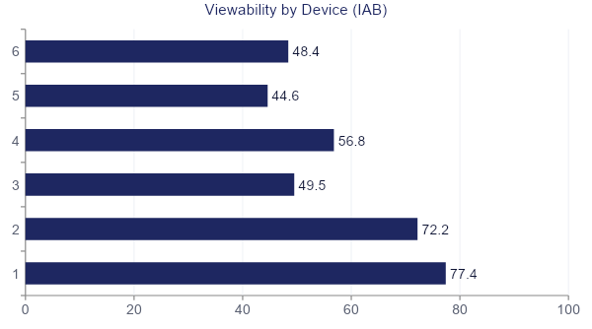
FOREX.com | GCG US Hispanic - March 2026
· QUANTCAST · PERFORMANCE
Scale delivered. Conversion Ad Sets above viewability benchmark.
SPEND
IMPRESSIONS
CLICKS
CPM
CONV (VT)
CPA
$12,159
5.86M
1,241
$1.99
2
$6079
Campaign Split
Campaign | Spend | Impr. | Clicks | Viewab. | Conv
Conversion - Ad Set A | $2,373 | 2.33M | 237 | 74.0% | 1
Conversion - Ad Set B | $2,278 | 2.36M | 229 | 73.9% | 1
Clicks - Ad Set A (3/26) | $3,754 | 0.58M | 373 | 48.2% | 0
Clicks - Ad Set B (3/26) | $3,753 | 0.59M | 402 | 48.9% | 0
ATTRIBUTION NOTE
Both recorded conversions are view-through attributed, from the Conversion campaigns on smartphone. Click-through attribution is being validated as part of the broader tracking setup in progress with the Central Team. Full conversion picture available once complete.
Monthly Performance Review
7 / 10

Slide 8
FOREX.com | GCG US Hispanic - March 2026
· QUANTCAST · HIGHLIGHTS & NEXT STEPS
Viewability floors set. Attribution validation in progress.
HIGHLIGHTS
OPTIMIZATION PRIORITIES
Quantcast delivered 5.86M impressions at $1.99 CPM — efficient reach for the US Hispanic programmatic market. The Conversion campaigns (Ad Sets A and B) ran above the 70% IAB viewability benchmark at 74%, which is the account's strongest inventory quality result this month.
The Clicks campaigns launched March 26. With six days of delivery, performance assessment carries into April as the first complete measurement period. Viewability on those placements will be reviewed once a full month of data is available.
Clicks campaign viewability will be reviewed once the 60% placement floor — applied in March — has a full month to affect delivery.
Click-through attribution is being validated with the Central Team. View-through conversions are recorded. Full attribution picture available in April.
US programmatic CPCs reflect market pricing for the Hispanic segment. Efficiency gains come from inventory quality and audience refinement, not from reducing spend.
Priority | Recommendation | Next Step | Owner / Due
CRITICAL | Set 60% viewability floor on Clicks campaign. | Placement-level threshold applied. | Completed
CRITICAL | Validate conversion tracking and attribution. | Central Team confirmation in progress. | Central Team
HIGH | Exclude low-quality inventory (tablets, low-viewability domains). | Placement exclusion list built and applied. | Completed
HIGH | Consolidate Conversion campaign ad sets to improve learning efficiency. | Ad set merge in progress; budget reallocation to follow. | BRLVNT · Apr 17
Monthly Performance Review
8 / 10

Slide 9
FOREX.com | GCG US Hispanic - March 2026
· AZERION · PERFORMANCE & NEXT STEPS
Ramp-up month on premium publisher inventory
SPEND
IMPRESSIONS
CLICKS
CTR
CPM
CONVERSIONS
$15,793
2.49M
3,028
0.12%
$6.33
7
$2,256 CPA
Delivery Quality
HIGHLIGHTS
Metric | Value | Benchmark / Note
Viewability | 66.08% | Below 70% IAB
Device Reach | 1.25M | 1.1 frequency
Frequency (reported) | 1.1 | Math discrepancy flagged
Attribution | Not disclosed | VT vs CT unknown
Revenue / ROAS | Not configured | Limits true ROI read
Premium inventory: Reuters, CNN, CBS News, NYT, Yahoo News, Trading Economics.
Low frequency (1.1) preserved unique reach across 1.25M devices.
Targeted Spanish-speaking US audiences in business/markets/tech.
7 first-month conversions establish initial CPA baseline.
RECOMMENDATIONS & NEXT STEPS
APRIL FOCUS
Apply placement exclusions to improve viewability above 70%; review inventory weekly.
Shift to conversion-optimized line items once March learning data is applied.
Confirm attribution methodology with Azerion; align reporting for April pulls.
Viewability optimization: placement exclusions are being applied to push delivery above the 70% IAB floor. Impact will be visible in April data.
CPA of $2,256 reflects a ramp-up period on a new channel. April is the first full measurement month and will establish the working baseline.
Monthly Performance Review
9 / 10

Slide 10
FOREX.com | GCG US Hispanic - March 2026
· RECOMMENDATIONS & NEXT STEPS
Closing the measurement loop in April
CRITICAL
HIGH
OPPORTUNITY
Complete Google Ads conversion tracking setup.
Deploy Trust and Platform landing pages via WebOps.
Address submission step drop-off on Meta.
Apply Azerion viewability optimizations for April.
Quantcast viewability floor + exclusions.
Brand search audit (match types, budget).
Shift Meta budget Track B → Track A.
Launch Meta leads-optimized campaign.
Non-brand Google QS lift (76-81% rank lost).
Consolidate Quantcast A/B Conversion ad sets.
Spanish-intent keyword expansion.
CTV brief before more creative spend.
Action | Owner
Google Ads conversion tracking setup | Central Team
Campaign CIDs for reporting | Mateus / Laura
Landing pages (Trust, Platform) go-live date | WebOps
Quantcast viewability floor + placement exclusions | BRLVNT
Meta leads-optimized campaign launch | BRLVNT
Meta Pixel review | Central team + BRLVNT
TikTok / Sprout restart path | Central Team
CTV / creative brief | FOREX + BRLVNT
Monthly Performance Review
10 / 10

